Slide 1
The Software Requirements Document Sometimes called Software Requirements Specification (SRS)
Instructor
Dr. Sultan s. alqahtani
Note: These are a slightly modified version of slides available from the author’s site https://www.slideshare.net/DanyalAkhlaq/software-requirements-specification-22497944

Slide 2
What is SRS
SRS is the official statement of what the system developers should implement.
SRS is a complete description of the behavior of the system to be developed.
SRS should include both a definition of user requirements and a specification of the system requirements.
The SRS fully describes what the system will do and how it will be expected to perform.

Slide 3
What is the purpose of SRS
The SRS precisely defines the software product that will be built.
SRS used to know all the requirements for the software development and thus that will help in designing the software .
It provides feedback to the customer.

Slide 4
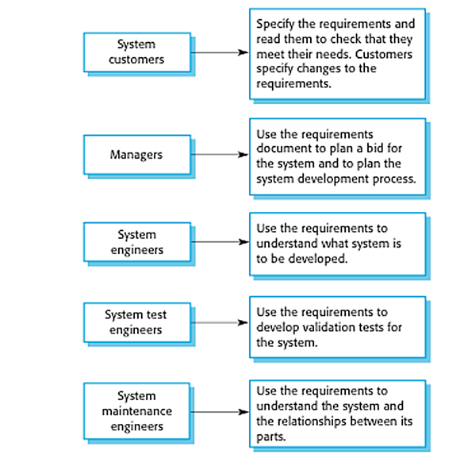
Users of a Requirements Document

Slide 5
Structured of Requirements Document
The most widely known standard is IEEE/ANSI 830-1998 (IEEE, 1998).
This IEEE standard suggests the following structure for requirements documents:

Slide 6
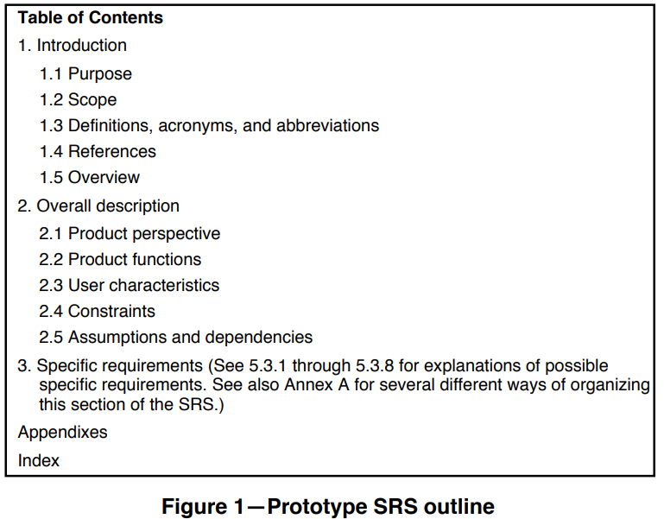
Please check
IEEEXplore-SRS-template.pdf

Slide 7
Structured Explained (Introduction)
Purpose
Describe the purpose of the SRS, not the purpose of the software being developed.
Intended audience for SRS
Scope
Describe application of software (benefits, objectives).
Explain what software will (not) do.

Slide 8
Structured Explained (Introduction)
Definitions/acronyms/abbreviations
Definitions of terms and abbreviations that are used in the SRS. E.g., user: the person operating and/or using the software systems.
References
A complete list of all documents referenced elsewhere in the SRS.
Specify the sources form which the references can be obtained.
Overview
Brief description of rest of SRS.
How the SRS is organized.

Slide 9
Structured Explained (Overall Description)
Product Perspective
If the product is independent and totally self-contained, it should be stated here.
Describe the functions of each component of the larger system or project, and identify interfaces.
Product Functions
Provide a summary of the functions that the software will perform.
Block diagrams showing the different functions and their relationships can be helpful.
User Characteristics
Describe those general characteristics of the eventual users of the product that will affect the specific requirements.

Slide 10
Structured Explained (Overall Description)
Constraints
Provide a general descriptions of any other items that will limit the developers’ options for designing the system. E.g., the software system will run under Windows, all code shall be written in Java.
Assumptions and Dependencies
List and description of each of the factors that affect the requirements stated in the SRS.
Apportioning of Requirements
Identify requirements that may be delayed until future versions of the systems.

Slide 11
Structured Explained (Specific Requirements)
External Interface Requirements
The characteristics that the software must support for each human interface to the software product. E.g., required screen format, page layout and controls of any reports or menus, network protocols, etc.
Functional Requirements
Performance Requirements
Capacity
No. of simultaneous users.
Processing requirements for normal and peak loads
Response time
System priorities for users and functions.

Slide 12
Structured Explained (Specific Requirements)
Design Constraints
Specify design constraints imposed by other standards, company policies, hardware limitation, etc. that will impact this software project.

Slide 13
Characteristics of good SRS
Correct: every requirement given in SRS is a requirement of the software.
Unambiguous: every requirement has exactly one interpretation.
Complete: include all functional, performance, design, external interface requirements; definition of the response of the software to all inputs.
Consistent: internal consistency.
Ranked importance: essential vs. desirable.

Slide 14
Characteristics of good SRS
Verifiable: a requirement is verifiable if and only if there exists some finite cost effective process with which a person or machine can check that the SW meets the requirement.
Modifiable: SRS must be structured to permit effective modifications (e.g., don’t be redundant, keep requirements separate)
Traceable: origin of each requirement is clear.

Slide 15
Project (Phase#2) materials
Project-phase 2: project requirements
Project-Phase-XX.. Help ☺
Srs_example_2010_grpup2 I like it.
Ask questions, search, look for examples, etc.

